Slide 1

Python for Geoscientists: Machine Learning and Beyond!
Izzul Qudsi

Slide 2
Who Am I?
What Python have done to me?
Geologist
Working as Technical Support of Horizon Perdana
Python helps my MSc
I included to the data management system developer team
A new toy during spare time

Slide 3
This talk
Introduction
What is python for us?
Examples

Slide 4
Geoscientists start to aware of the Machine Learning techniques?
In the past few years, the interest on Machine Learning (ML) discussion grows significantly around the geoscience society. In fact, this technique always been there for years with less of them realizing.
Python has been used by many geoscientific software developers as the plug-in for the implementation of machine learning module on their products in the last few years.
Here in Indonesia, this topic has been very pouplar recently, especially during the COVID-19 lockdown period. Many of them are starting to learn Python to catch up with the hype of ML discussions.

Slide 5
Machine Learning
Machine Learning (ML)
ML is a branch of Data Science
Using the algorithm to use the data, learn from it, and predict the future trend for that dataset
ML in Geoscientific matters
Machine learning requires a good amount of data to produce a better result.
Process that require mapping an input to a well defined input is the best place where ML could help.
Most of modelling techniques are ML.

Slide 6
Python offers various solutions for Geoscientists
What kind of problems?
Data Management
The need of data-driven / advanced quantitative analysis
Limited access to technical software
Beyond conventional analysis
Time-consuming repetitive manual tasks that could also lead to HUMAN ERRORS
etc

Slide 7
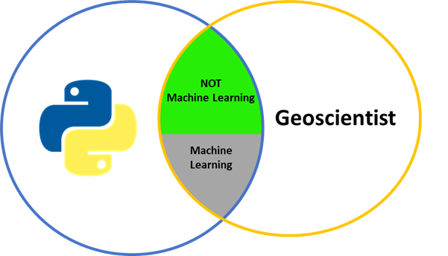
Python is not only about machine learning
ML examples
- Facies Classification - Lineament Analysis
- Fault identification - etc.
- Hyperspectral Image mineral mapping
non-ML examples
- Petrophysics calculation - Create your own software
- DEM visualization - etc.
- Well Log and SegY visualization

Slide 8
What is Python for YOU as geoscientist?
IT’S A TOOL
A casual tool
A problem solving tool
A developing tool

Slide 9
Let’s get started!
Examples:
Curie Point Depth Mapping Using Aeromagnetic Data for Geothermal Exploration
Playing Around with Well Log Data
Fault Identification on Seismic Data
Python-made Geoscientific Softwares

Slide 10
Example 1
Curie Point Depth Mapping Using Aeromagnetic Data for Geothermal
No ML used
Processing Aeromagnetic Data
Actual Problem Solved

Slide 11
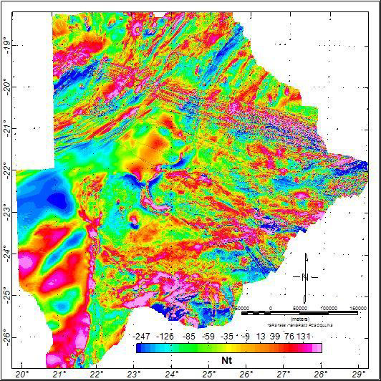
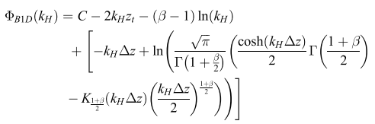

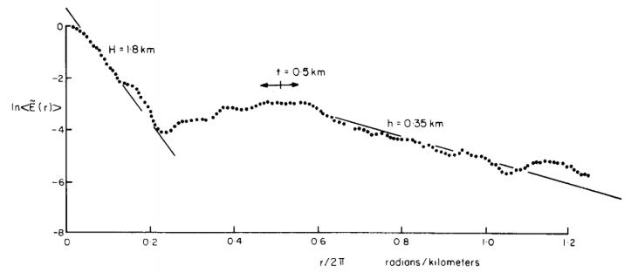
Curie Point Depth Mapping Underneath Botswana for Geothermal Prospect Identification Using Aeromagnetic Data
Curie Point Depth is the depth where the magnetic property losing its ability at 851 Kelvin
CPD calculation Using Python

Slide 12
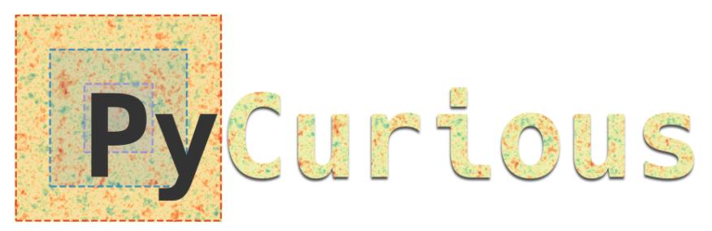

CPD calculation Using Python

Slide 13
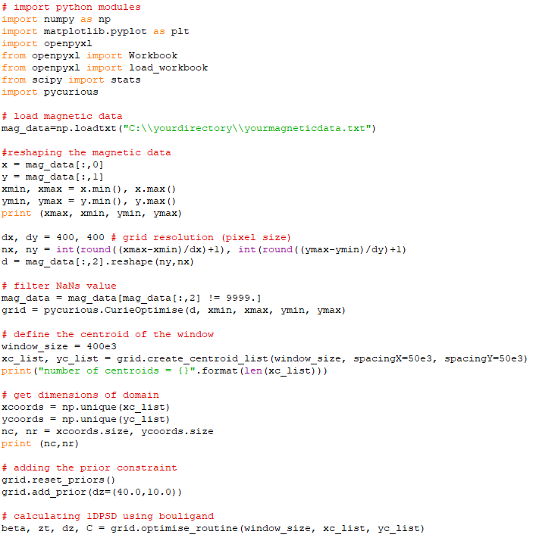
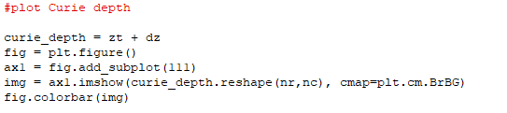
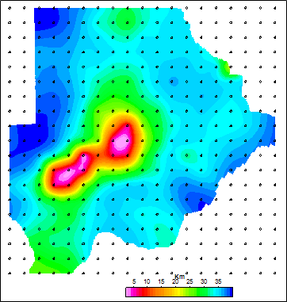
CPD calculation Using Python

Slide 14
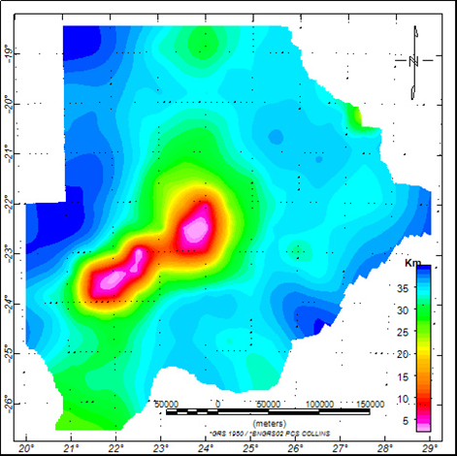
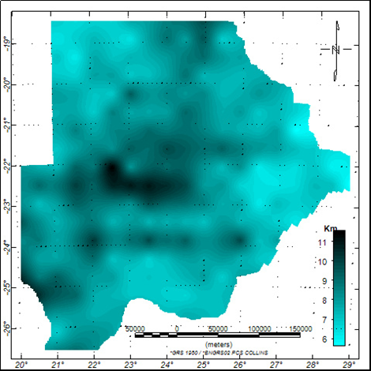
Metropolis Hastings: Markov Chain Monte Carlo
CPD calculation Using Python

Slide 15
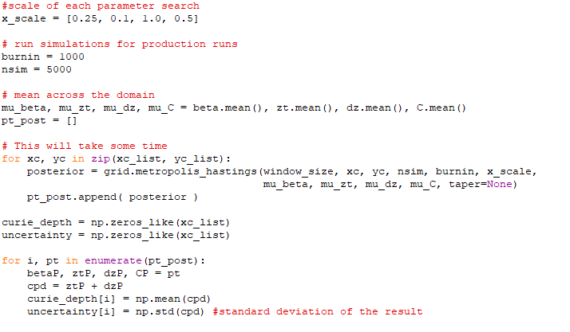
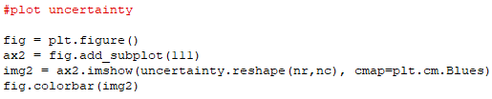
CPD calculation Using Python

Slide 16
CPD calculation Using Python

Slide 17
Example 2
Playing Around with Well Log data
Processing well log data (LAS file)
Using simple machine learning
Adapted from a journal draft

Slide 18
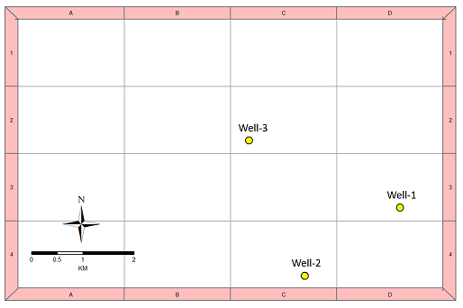
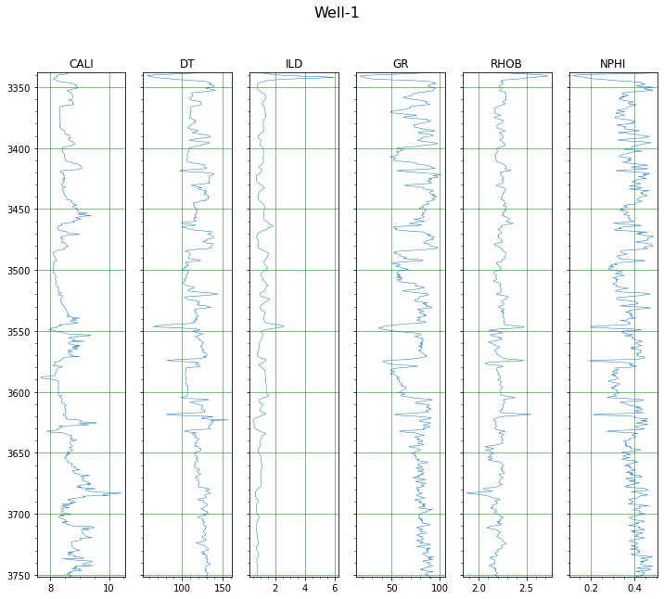
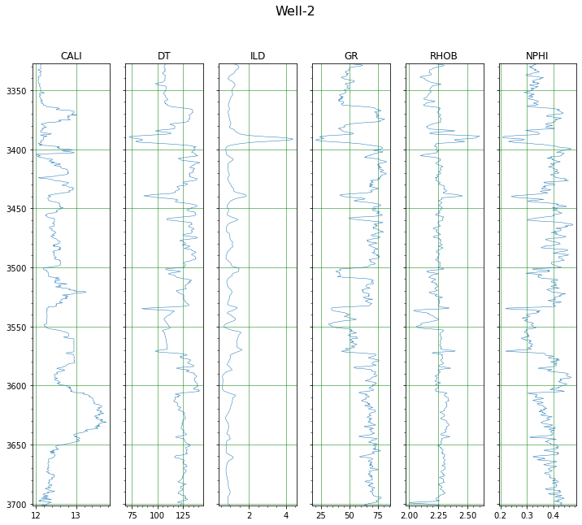
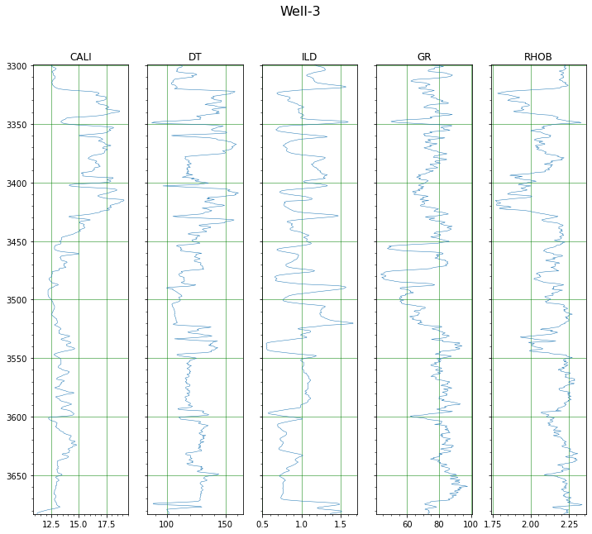
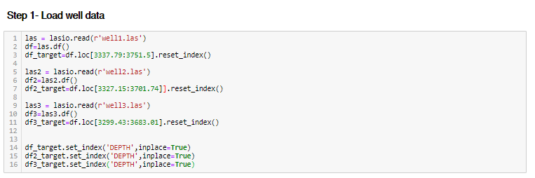
Missing Log Prediction

Slide 19
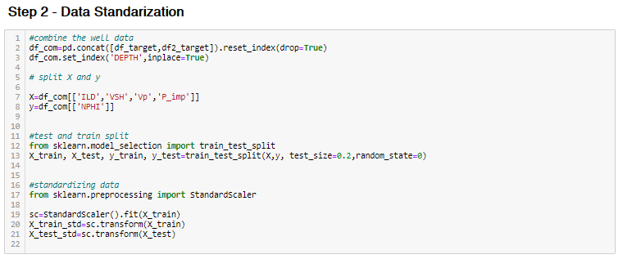
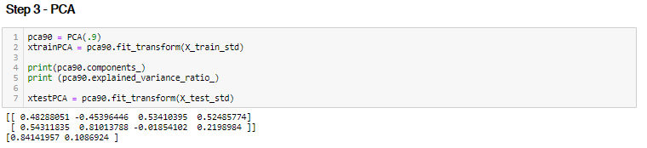
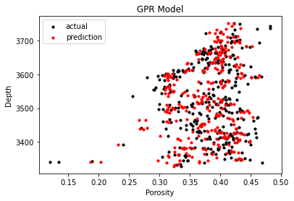
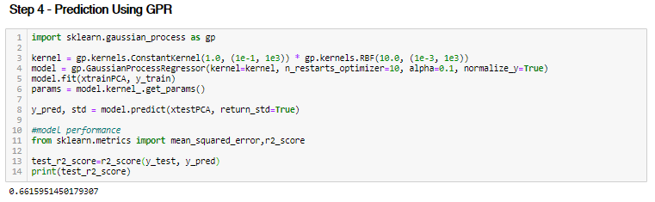
Missing Log Prediction

Slide 20
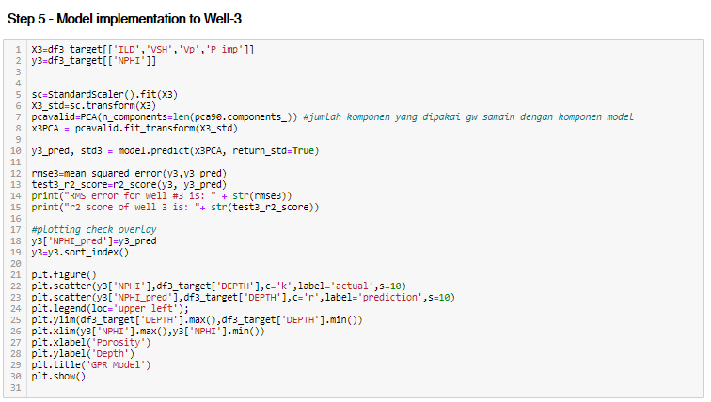
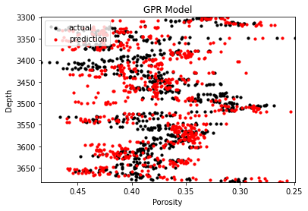
Missing Log Prediction

Slide 21
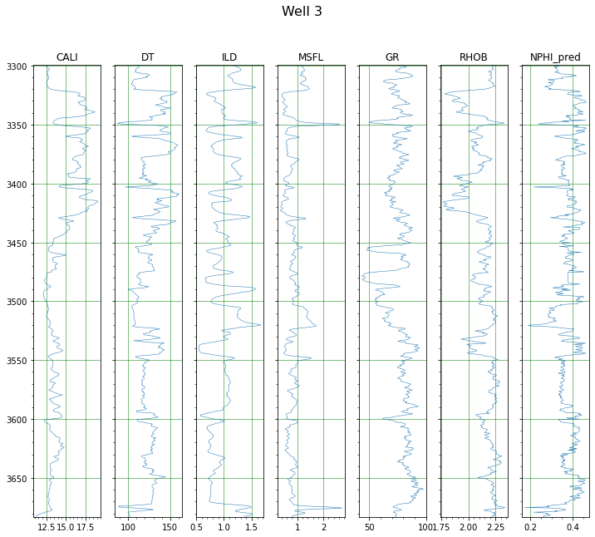
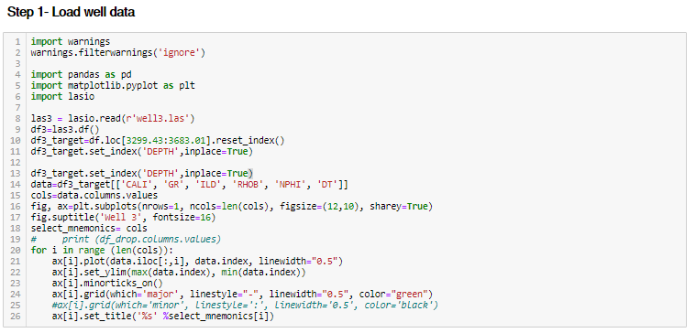
Petrophysics Calculation

Slide 22
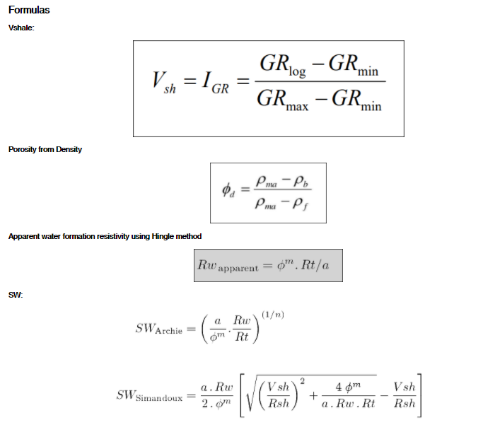
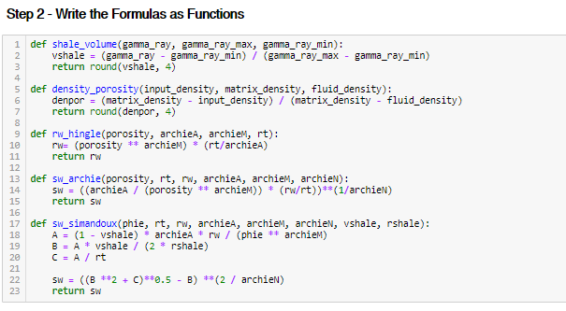
Petrophysics Calculation

Slide 23
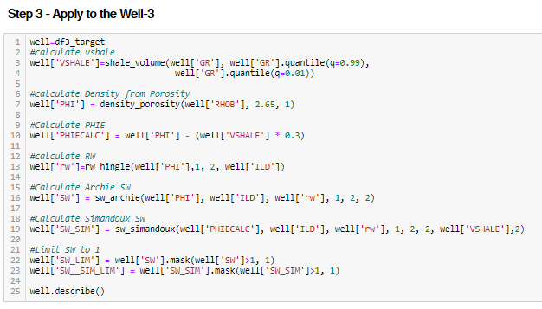
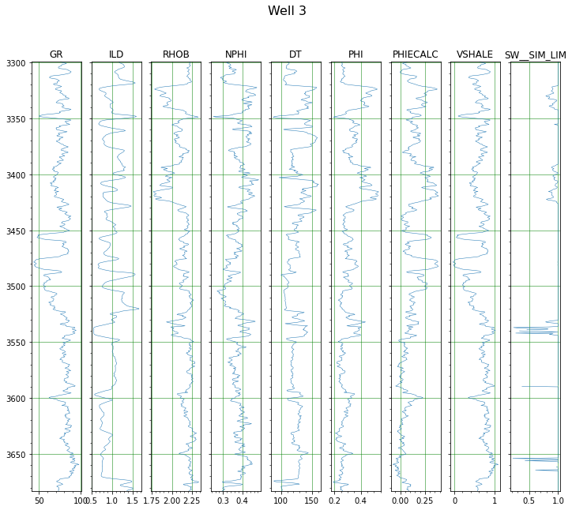
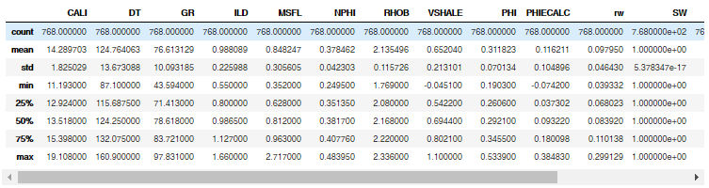
Petrophysics Calculation

Slide 24
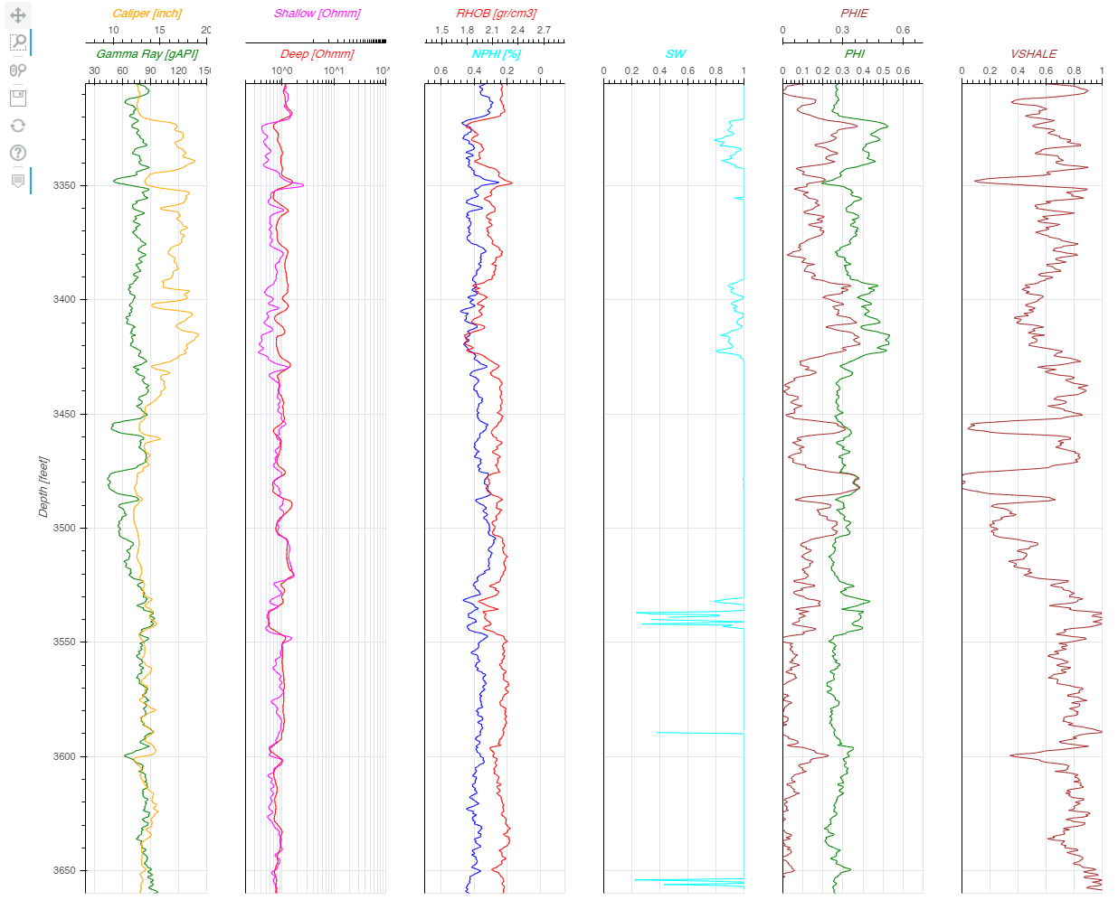
Petrophysics Calculation

Slide 25
Example 3
Fault Identification on Seismic
Processing SegY file
Using a library that applying machine learning
https://github.com/xinwucwp/faultSeg

Slide 26
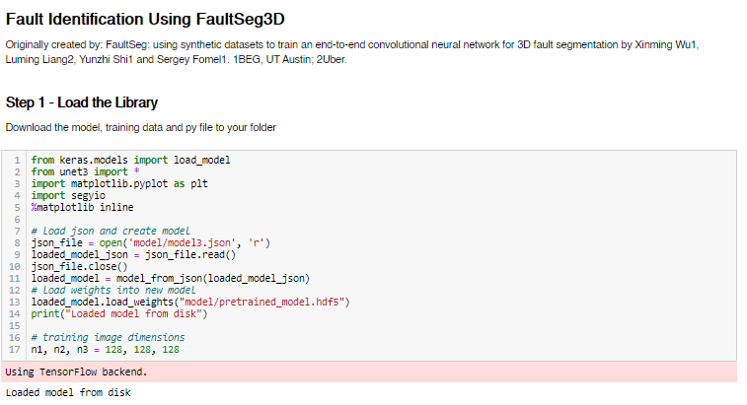
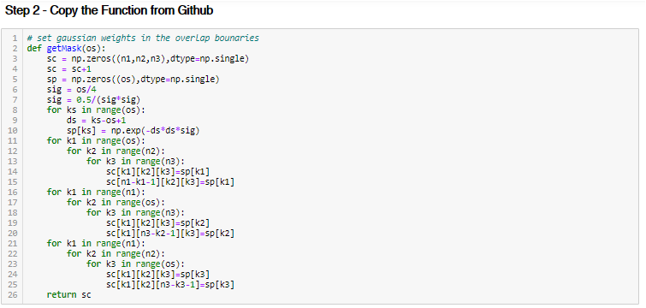
Fault Identification on Seismic

Slide 27
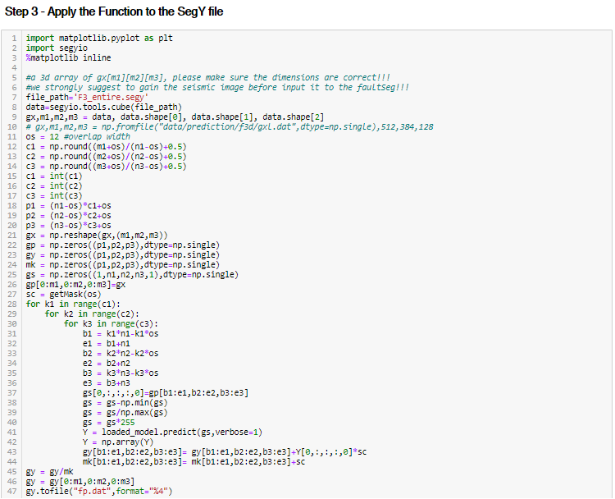
Fault Identification on Seismic

Slide 28
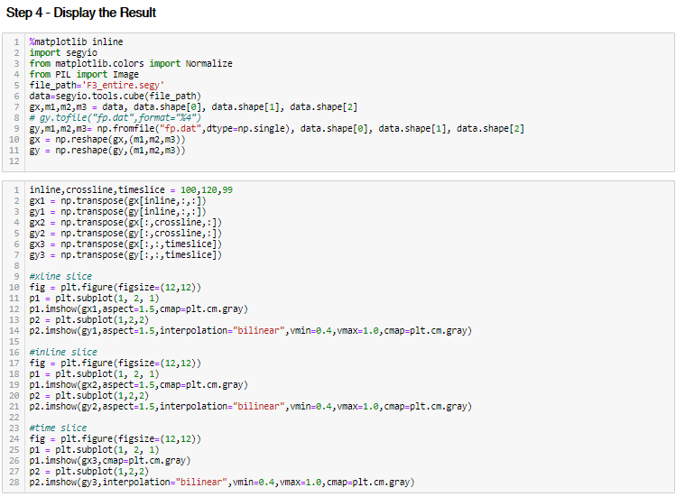
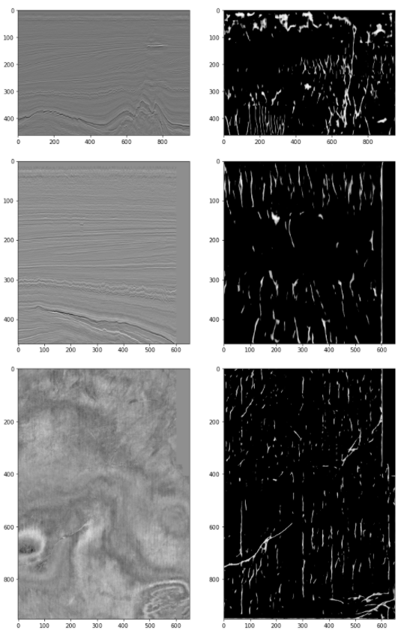
Fault Identification on Seismic

Slide 29
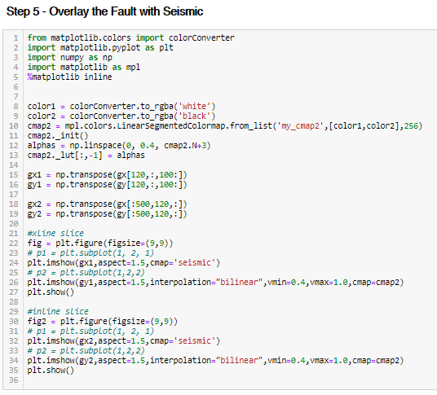
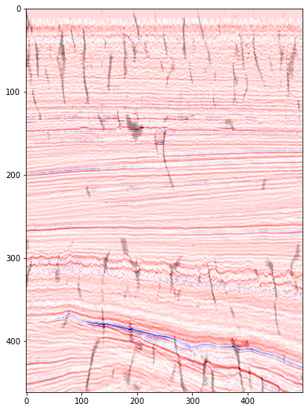
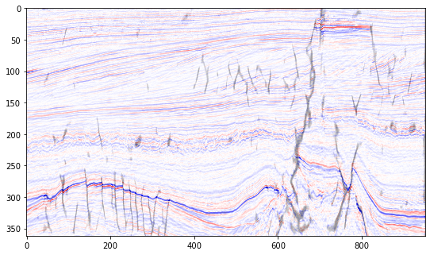
Fault Identification on Seismic

Slide 30
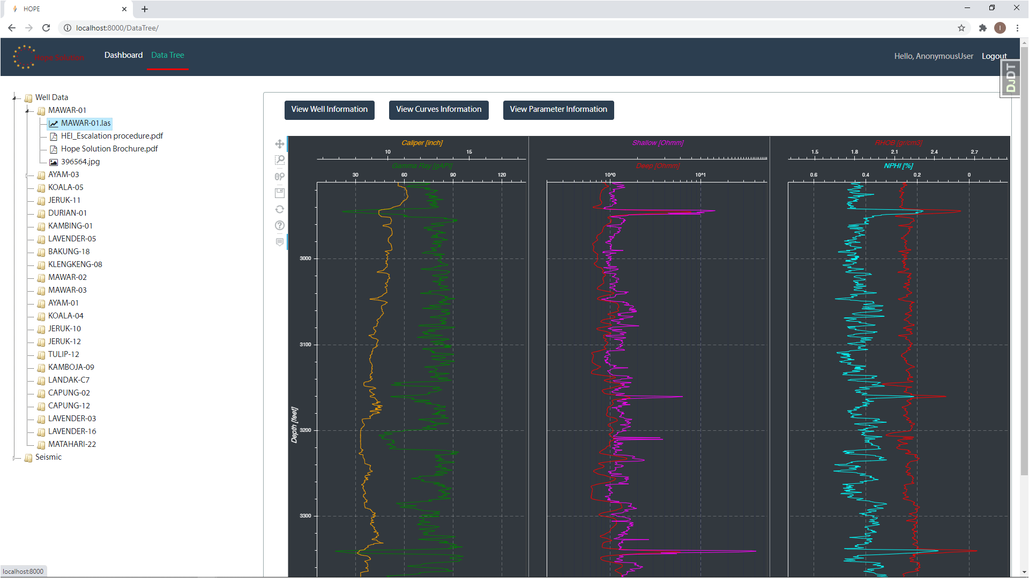
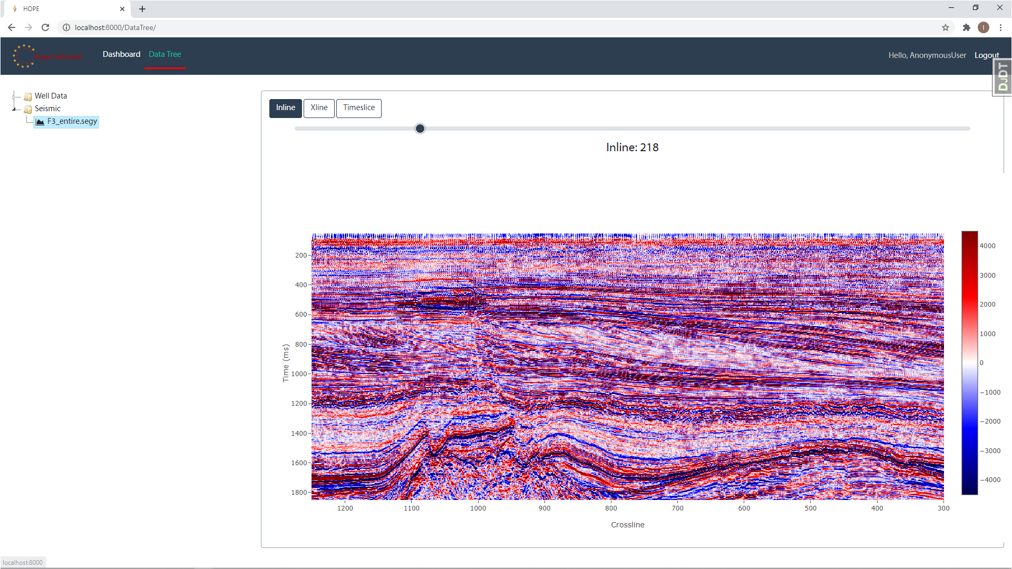
Bonus

Slide 31




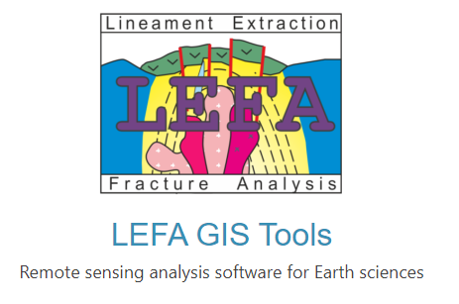
Build Your Own Software
Hyperspectral Python (HypPy)

Slide 32
Conclusion
Python is not just a machine learning tool
YOU can do almost anything you want
Everyone can write Python codes
Python & Machine Learning will never replace Geoscientist
“Geoscientist role is to supervise the result of the unsupervised method”

Slide 33



Dank je wel!
@panjoel4

